Slide 1
Project 1: Data Analysis
Presented By:
Nathan Jones & Holden Nichols

Slide 2
The Data we have…
4 tables: Links, Movies, Ratings, Tags
9 Unique Columns: movieID, imbdId, tmdbId, userId, rating, timestamp, tag, title, genres
Number of Movies in database: 62,424 Users in database: 162,542
Database Structure
Links
movieId
imbdId
tmdbId
Movies
movieId
title
genres
Ratings
userId
movieId
rating
timestamp
Tags
userId
movieId
tag
timestamp

Slide 3
The Team’s Task…
Analyze and Display Data related to the given data via query construction.
Our project focus oriented around specific analysis of ratings within the dataset and how it relates with other values within the database.
The questions we asked ourselves to find relationships between ratings and the rest of the data were:
What are the Top 25 rated movies having at least 50 views?
What is the most popular rating and how are ratings distributed across the dataset?
What is the average rating for movies given a certain year?
What are the rating averages for specific users?

Slide 4
The Queries used…
What are the Top 25 rated movies having at least 50 views?
SELECT movies.title AS Titles, COUNT(ratings.movieid) AS Views, AVG(ratings.rating) AS Avg_Score FROM ratings, movies WHERE movies.movieid = ratings.movieid GROUP BY ratings.movieid, title HAVING COUNT(ratings.movieid) > 50 ORDER BY AVG(ratings.rating) DESC limit 25;
What is the most popular rating and how are ratings distributed across the dataset?
SELECT rating, COUNT(rating) AS Times_Chosen FROM ratings GROUP BY rating ORDER BY Times_Chosen DESC;
What is the average rating for movies given a certain year?
SELECT from_unixtime(unixtimestamp, 'yyyy') AS year, AVG(rating) AS average_rating FROM ratings GROUP BY from_unixtime(unixtimestamp, 'yyyy') ORDER BY AVG(rating) DESC;
SELECT from_unixtime(unixtimestamp, 'yyyy') AS year, AVG(rating) AS average, COUNT(from_unixtime(unixtimestamp, 'yyyy')) AS Votes FROM ratings GROUP BY from_unixtime(unixtimestamp, 'yyyy') ORDER BY AVG(rating) DESC;
What are the rating averages for specific users?
SELECT userid, AVG(rating) from ratings GROUP BY userid ORDER BY userid limit 25;
SELECT userid, AVG(rating) from ratings HAVING AVG(rating) < 3.6 GROUP BY userid ORDER BY userid limit 25;

Slide 5
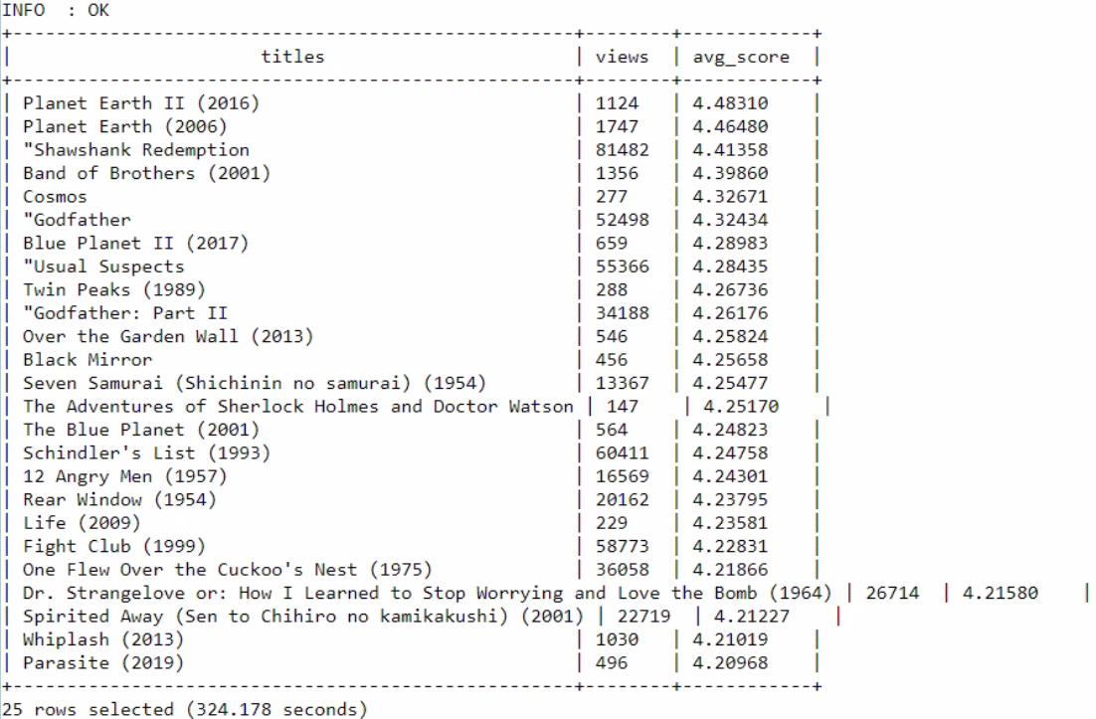
The Output…
What are the Top 25 rated movies having at least 50 views?
SELECT movies.title AS Titles, COUNT(ratings.movieid) AS Views, AVG(ratings.rating) AS Avg_Score FROM ratings, movies WHERE movies.movieid = ratings.movieid GROUP BY ratings.movieid, title HAVING COUNT(ratings.movieid) > 50 ORDER BY AVG(ratings.rating) DESC limit 25;

Slide 6
Relating the Output…
Highest rated movies with at least 50 ratings
Cut out most outliers by specifying minimum view count
Useful to make predictions or decisions about future releases
See the reach of a movie as well as its general reception

Slide 7
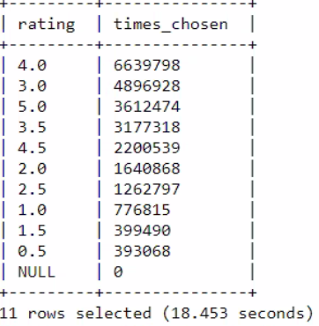
The Output…
What is the most popular rating and how are ratings distributed across the dataset?
SELECT rating, COUNT(rating) AS Times_Chosen FROM ratings GROUP BY rating ORDER BY Times_Chosen DESC;

Slide 8
Relating the Output…
Highest rating selection & rating scale median
4 is most popular rating, 2.5 is the median on the scale but is in the lower half of popularity
Correlational Evidence to support statements
“Movies are usually better than the average perception of a movie”
“There is a positive bias towards movies for those that rate movies”

Slide 9
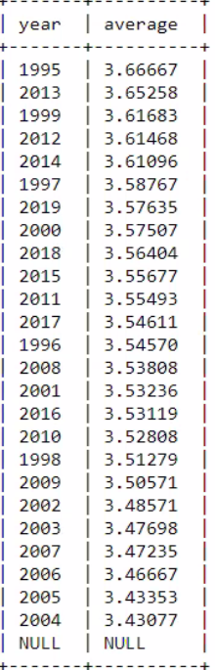
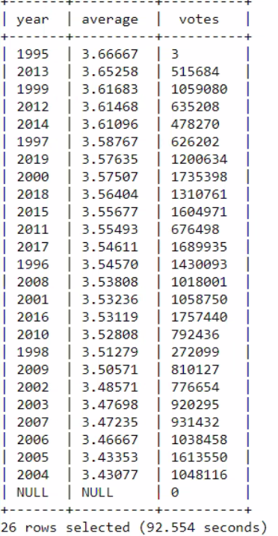
The Output…
What is the average rating for movies given a certain year?
SELECT from_unixtime(unixtimestamp, 'yyyy') AS year, AVG(rating) AS average_rating FROM ratings GROUP BY from_unixtime(unixtimestamp, 'yyyy') ORDER BY AVG(rating) DESC;
SELECT from_unixtime (unixtimestamp, 'yyyy') AS year AVG(rating) AS average, COUNT(from_unixtime(unixtimestamp, 'yyyy')) AS Votes FROM ratings GROUP BY from_unixtime(unixtimestamp, 'yyyy') ORDER BY AVG(rating) DESC;

Slide 10
Relating the Output…
Average user rating sorted by year
Can determine the general mood of the public towards the movies released that year
Data validation step
While 1995 may appear to have been the best year for movies, a closer look reveals that only 3 ratings were given
What this means
We cannot make assertions about 1995, but we can speculate about causes for average ratings on a per year basis for others

Slide 11
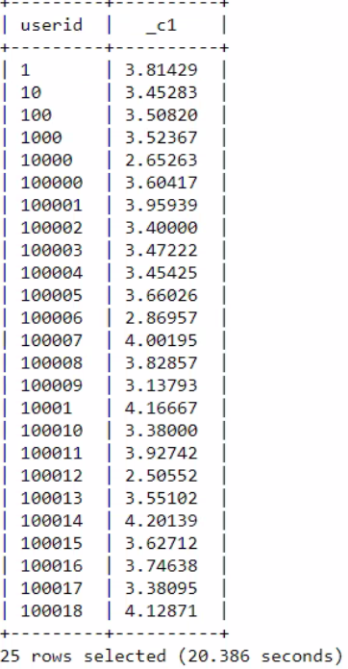
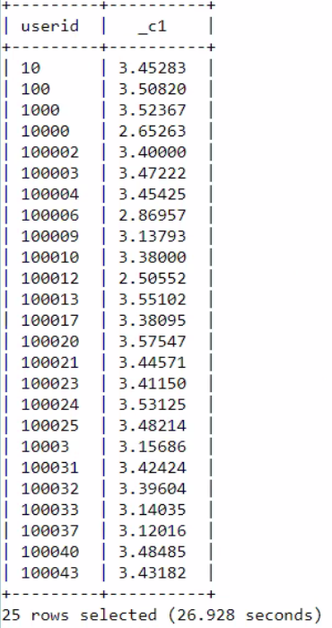
The Output…
What are the rating averages for specific users?
SELECT userid, AVG(rating) from ratings GROUP BY userid ORDER BY userid limit 25;
SELECT userid, AVG(rating) from ratings HAVING AVG(rating) < 3.6 GROUP BY userid ORDER BY userid limit 25;

Slide 12
Relating the Output…
Display of users and their average rating score
Limited to first 25 users, due to over 162 thousand users.
Utilize information to remove biased users
Identify users that are outliers in the data and remove them to limit positive or negative bias
Display of users with removal of “positive bias”
Arbitrarily used 3.6 as the cutoff for positive bias. True deviation point could be calculated by further look into distribution of scores.
Things of note when removing bias
Ensure that the removal of a user is genuinely biased. With current approach, one could potentially remove users without bias that have only rated highly rated movies

Slide 13
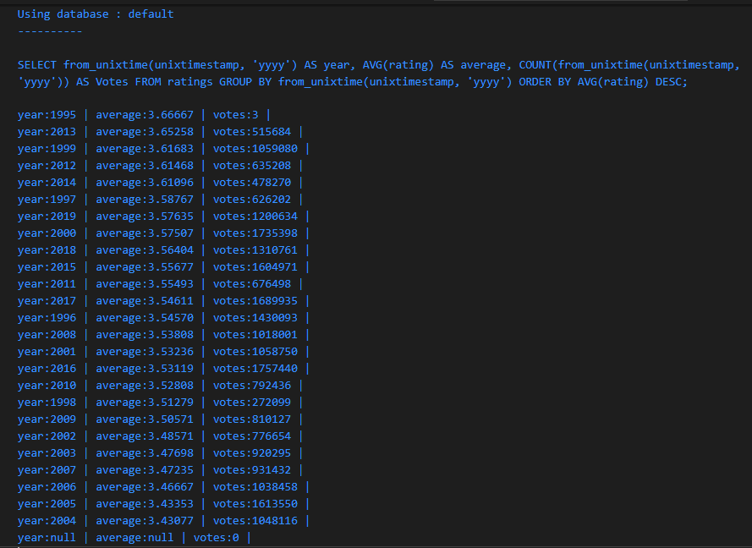
Scala connection…
Scala code was written to execute queries through an established Hive connection and display the output to the Scala terminal.
For the purposes of this project we have this “hard-coded”, but it is flexible enough to function with a wide variety of queries.
An example of the output from the Scala program is shown for reference.

Slide 14
Conclusions/Closing
We can determine the most popular movies by looking at a the highest user ratings above a certain view threshold
There is a high disposition towards rating a movie 4.0 / 5.0, with general bias towards higher scores
Average user ratings per year can fluctuate according to events during that year, but early 2000’s seemed to be a rough patch for movies based on user reviews
Some users may have individual high or low biases for rating movies, so it may be beneficial to discount outliers

